Slide 1
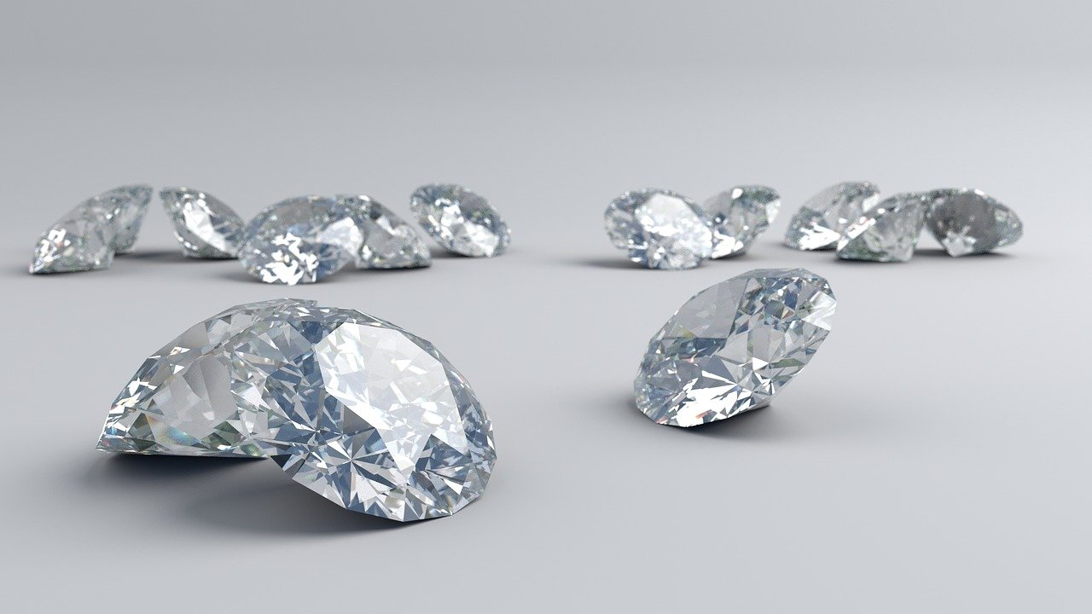
Diamond Price Prediction
Supervised Learning Project for Statistical Learning
Author: Marco Cazzola

Slide 2
RESEARCH QUESTIONS
Which are the most important factors in determining a diamond’s price?
What are the effects of such factors?
Is there a way to accurately predict a diamond’s price?

Slide 3
DATA SUMMARY
Data cleaning and eventual inconsistency
1

Slide 4
DATA DEFINITION
Price: price of the diamond in USD. Target variable.
Carat: weight of the diamond.
Depth: depth expressed relative to width and length
Clarity: how clear the diamond is (I1 = Worst; IF = Best)
Color: diamond’s color (J = Worst; D = Best)
Cut: quality of the cut (Fair = Worst; Ideal = Best).
Table: width of top of diamond relative to the widest point
X: length in mm
Y: width in mm
Z: depth in mm

Slide 5
STATISTIC SUMMARY
 | Price | Carat | Depth | Table | X | Y | Z
Min | 326 | 0.2 | 43 | 43 | 0 | 0 | 0
1st Qu. | 950 | 0.4 | 61 | 56 | 4.71 | 4.72 | 2.91
Mean | 3933 | 0.7979 | 61.75 | 57.46 | 5.731 | 5.735 | 3.539
3rd Qu. | 5324 | 1.04 | 62.50 | 59 | 6.54 | 6.54 | 4.04
Max | 18823 | 5.01 | 79 | 95 | 10.74 | 58.9 | 31.8

Slide 6
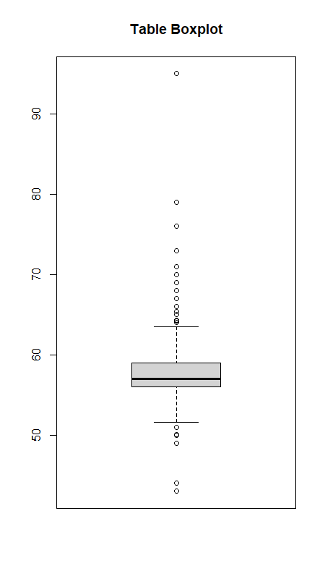
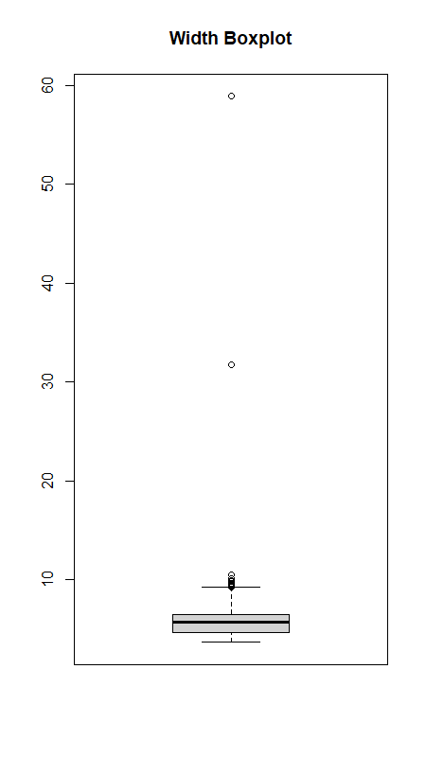
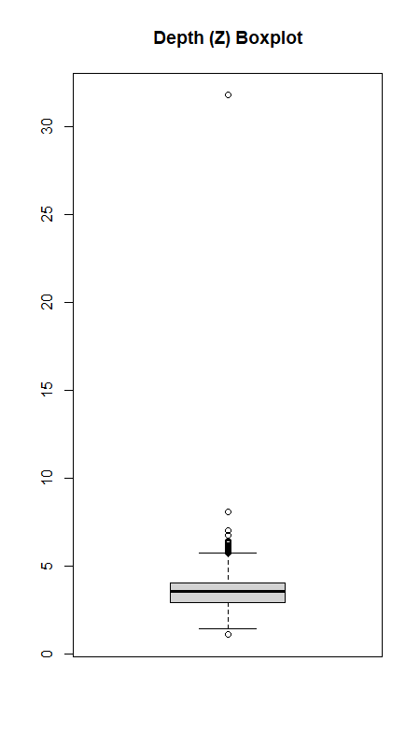
OUTLIERS DETECTION

Slide 7
DESCRIPTIVE STATISTICS
Predictors’ distributions and relationship with the response
2

Slide 8
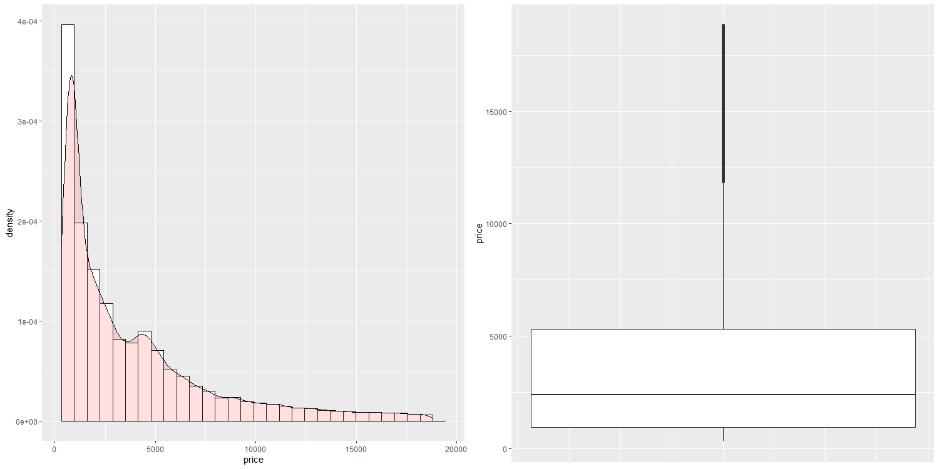
TARGET VARIABLE

Slide 9
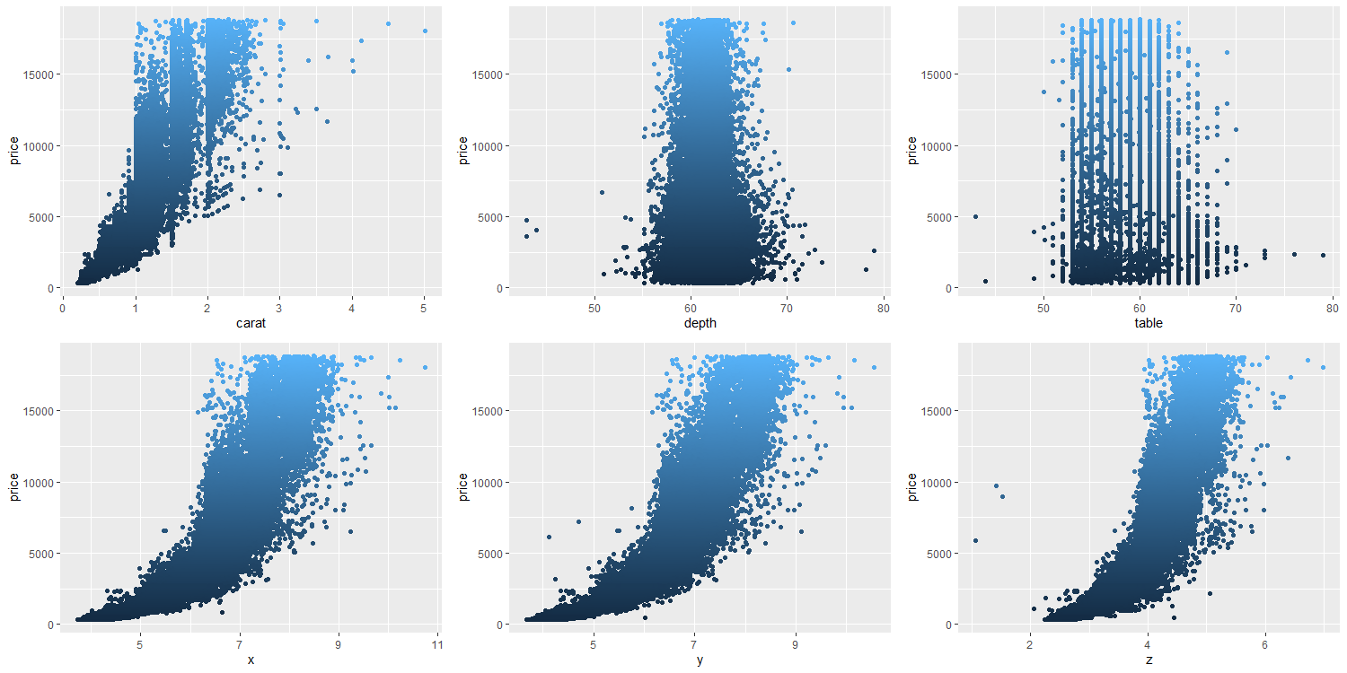
QUANTITATIVE PREDICTORS

Slide 10
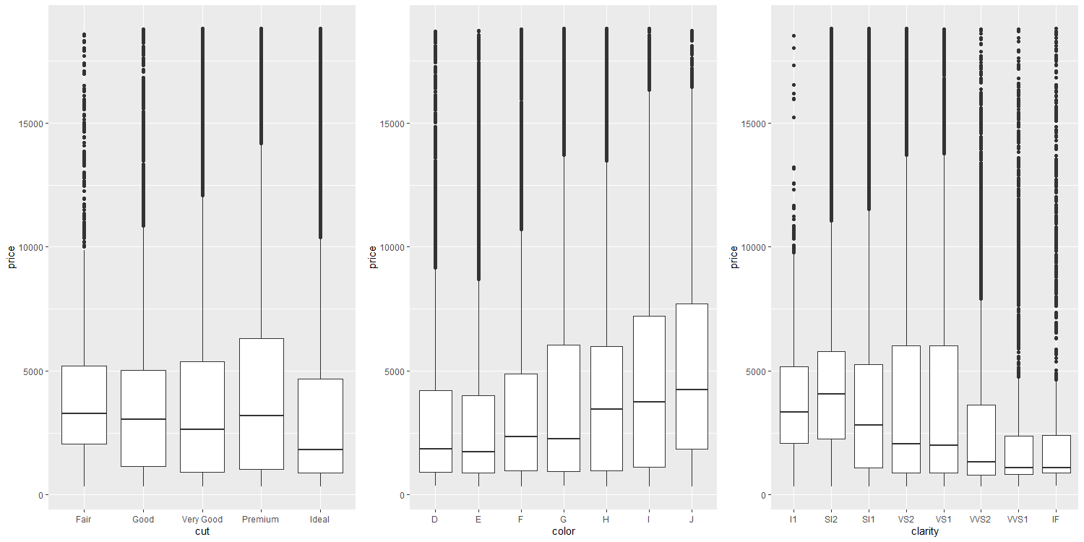
QUALITATIVE PREDICTORS

Slide 11
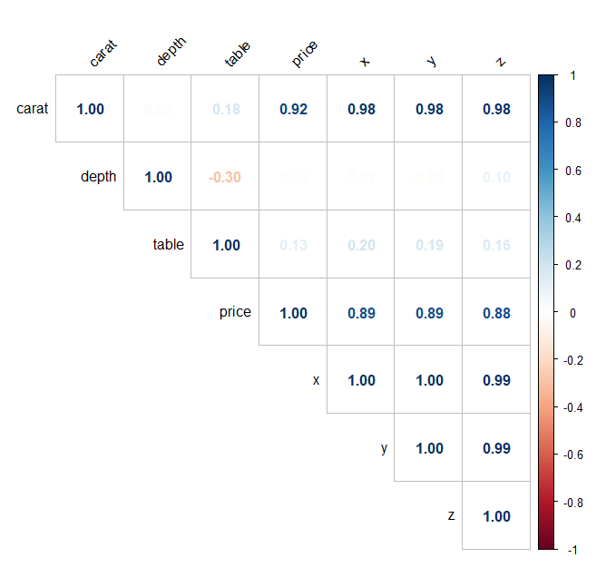
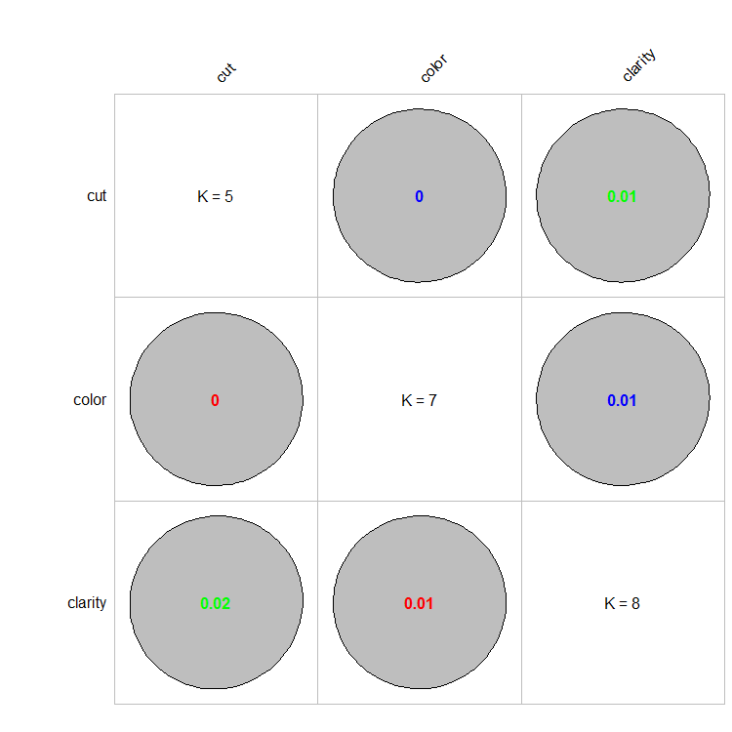
COLLINEARITY CHECKS

Slide 12
SIMPLE PARAMETRIC MODELS
Predicting a diamond’s price considering just its carat
3

Slide 13
SIMPLE LINEAR REGRESSION
 | Estimate | Std. Error | t-value | p-value
Intercept | 8.45 | 0.0016 | 5157.4 | < 2 × 10⁻¹⁶
Log(carat) | 1.67 | 0.0023 | 724.8 | < 2 × 10⁻¹⁶

Slide 14
Training R²
TRAINING MSE
TEST MSE
0.933
0.069
0.069

Slide 15
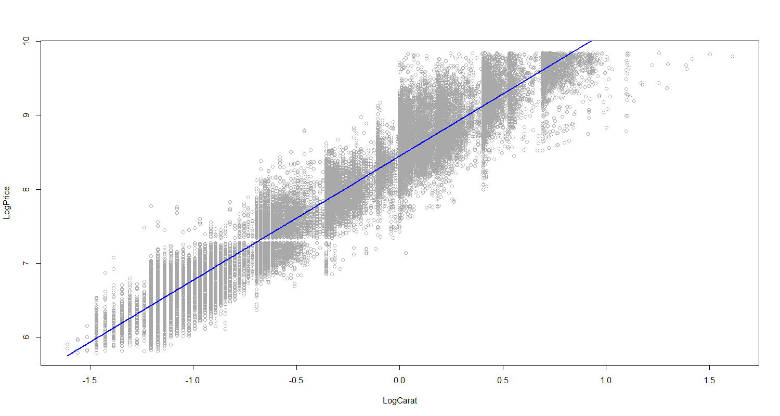
SIMPLE LINEAR REGRESSION

Slide 16
SIMPLE POLYNOMIAL REGRESSION
Let’s see if, by introducing polynomial transformations of the original predictor, we can get better performances.

Slide 17
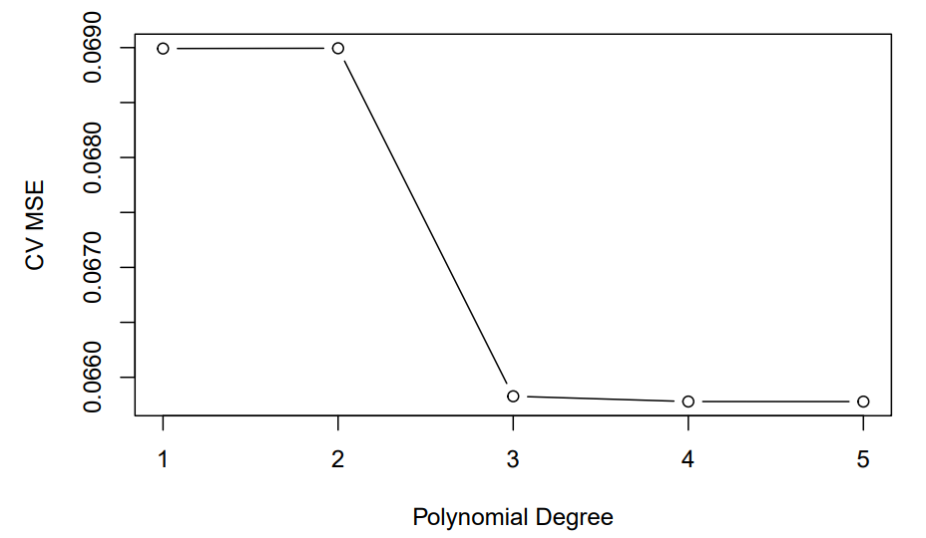
SELECTING THE POLYNOMIAL DEGREE

Slide 18
SIMPLE POLYNOMIAL REGRESSION
 | Estimate | Std. Error | t-value | p-value
Intercept | 7.79 | 0.0013 | 5897.33 | < 2 × 10⁻¹⁶
Log(carat) | 227.76 | 0.3067 | 742.586 | < 2 × 10⁻¹⁶
Log(carat)² | 0.146 | 0.3063 | 0.477 | 0.634
Log(carat)³ | – 13.27 | 0.3069 | -43.234 | < 2 × 10⁻¹⁶

Slide 19
Training R²
TRAINING MSE
TEST MSE
0.9361
0.066
0.066

Slide 20
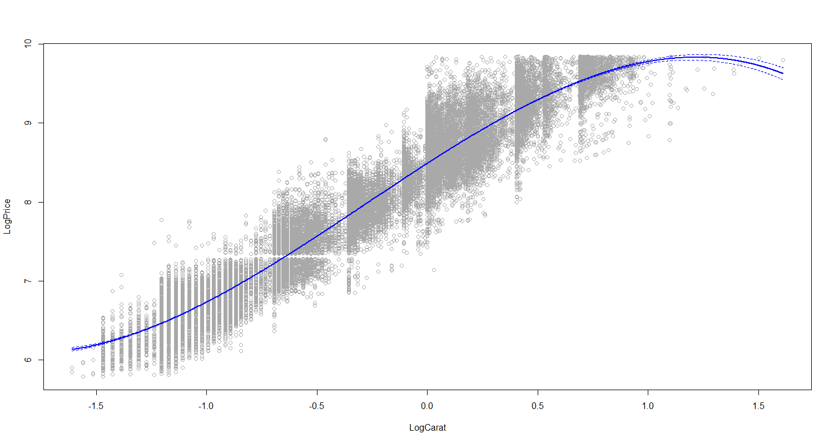
SIMPLE POLYNOMIAL REGRESSION

Slide 21
multivariate PARAMETRIC MODELS
4
Predicting a diamond’s price considering all the available predictors

Slide 22
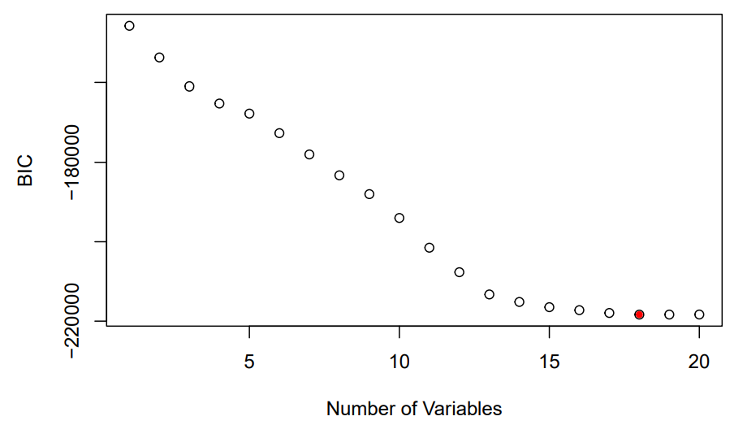
Feature selection
depth
table

Slide 23
Multiple linear regression / 1
 | Estimate | p-value |  | Estimate | p-value
Log(carat) | 1.88 | < 2 × 10⁻¹⁶ | Clarity5 | 0.82 | < 2 × 10⁻¹⁶
Clarity2 | 0.43 | < 2 × 10⁻¹⁶ | Clarity6 | 0.95 | < 2 × 10⁻¹⁶
Clarity3 | 0.59 | < 2 × 10⁻¹⁶ | Clarity7 | 1.02 | < 2 × 10⁻¹⁶
Clarity4 | 0.75 | < 2 × 10⁻¹⁶ | Clarity8 | 1.12 | < 2 × 10⁻¹⁶

Slide 24
Multiple linear regression / 2
 | Estimate | p-value |  | Estimate | p-value
Color2 | 0.14 | < 2 × 10⁻¹⁶ | Color7 | 0.51 | < 2 × 10⁻¹⁶
Color3 | 0.26 | < 2 × 10⁻¹⁶ | Cut2 | 0.08 | < 2 × 10⁻¹⁶
Color4 | 0.35 | < 2 × 10⁻¹⁶ | Cut3 | 0.12 | < 2 × 10⁻¹⁶
Color5 | 0.41 | < 2 × 10⁻¹⁶ | Cut4 | 0.14 | < 2 × 10⁻¹⁶
Color6 | 0.45 | < 2 × 10⁻¹⁶ | Cut5 | 0.16 | < 2 × 10⁻¹⁶

Slide 25
Training R²
TRAINING MSE
TEST MSE
0.9825
0.018
0.018

Slide 26
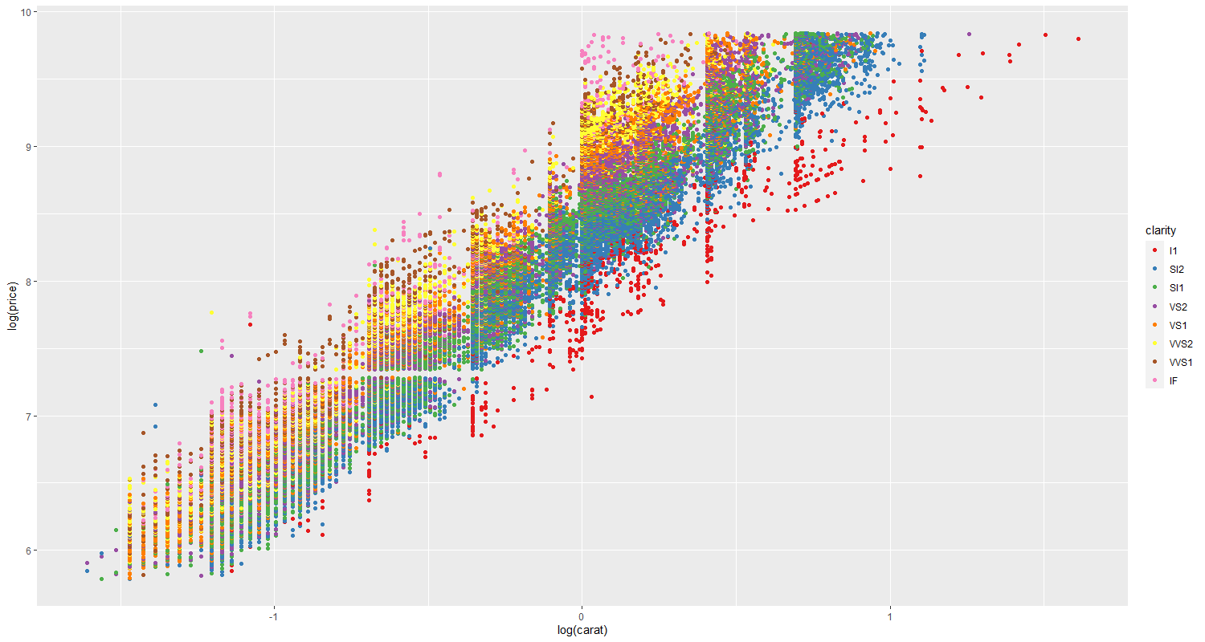
Categorical variable INTERPRETATION

Slide 27
MULTIPLE POLYNOMIAL REGRESSION
We now regress the price onto the cubic orthogonal polynomial of the logarithm of carat and the three categorical predictors.

Slide 28
Multiple polynomial regression / 1
 | Estimate | p-value |  | Estimate | p-value
Log(carat) | 255.45 | < 2 × 10⁻¹⁶ | Clarity4 | 0.73 | < 2 × 10⁻¹⁶
Log(carat)² | 2.7 | < 2 × 10⁻¹⁶ | Clarity5 | 0.80 | < 2 × 10⁻¹⁶
Log(carat)³ | – 10.14 | < 2 × 10⁻¹⁶ | Clarity6 | 0.93 | < 2 × 10⁻¹⁶
Clarity2 | 0.42 | < 2 × 10⁻¹⁶ | Clarity7 | 1.00 | < 2 × 10⁻¹⁶
Clarity3 | 0.59 | < 2 × 10⁻¹⁶ | Clarity8 | 1.10 | < 2 × 10⁻¹⁶

Slide 29
Multiple polynomial regression / 2
 | Estimate | p-value |  | Estimate | p-value
Color2 | 0.13 | < 2 × 10⁻¹⁶ | Color7 | 0.51 | < 2 × 10⁻¹⁶
Color3 | 0.25 | < 2 × 10⁻¹⁶ | Cut2 | 0.08 | < 2 × 10⁻¹⁶
Color4 | 0.34 | < 2 × 10⁻¹⁶ | Cut3 | 0.11 | < 2 × 10⁻¹⁶
Color5 | 0.41 | < 2 × 10⁻¹⁶ | Cut4 | 0.13 | < 2 × 10⁻¹⁶
Color6 | 0.45 | < 2 × 10⁻¹⁶ | Cut5 | 0.16 | < 2 × 10⁻¹⁶

Slide 30
Training R²
TRAINING MSE
TEST MSE
0.9844
0.016
0.016

Slide 31
REGRESSION TREE
A non-parametric approach
5

Slide 32
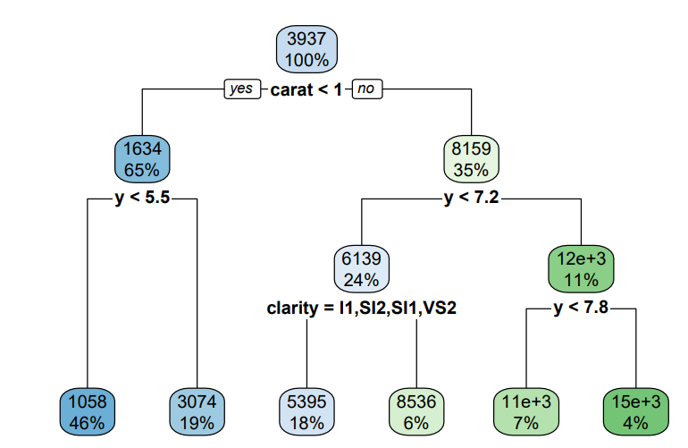
Regression tree

Slide 33
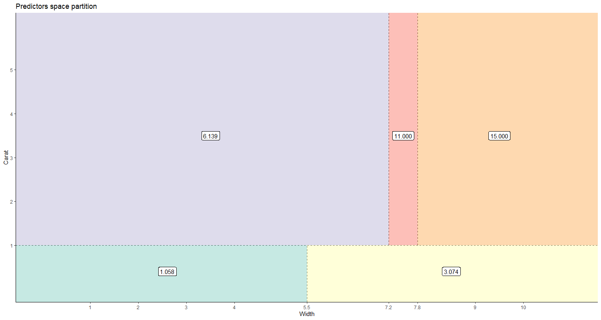
FEATURES SPACE PARTITION
6.139 $
11.000 $
15.000 $
1.058 $
3.074 $

Slide 34
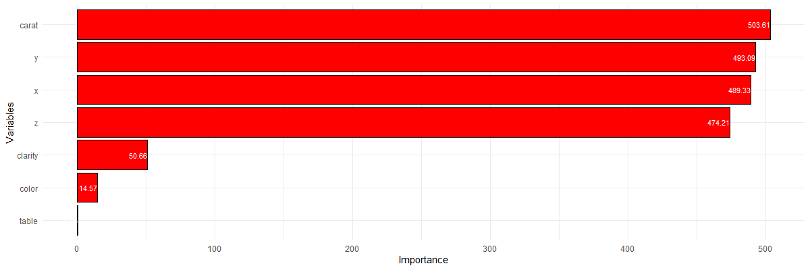
VARIABLES IMPORTANCE
carat
506.83
y
495.85
x
492.09
z
476.93
clarity
50.72
color
14.77
table
0.38

Slide 35
Training PSEUDO R²
TRAINING RMSE
TEST RMSE
0.88
1378.60
1386.03

Slide 36
BAGGING
Ensemble methods
6

Slide 37
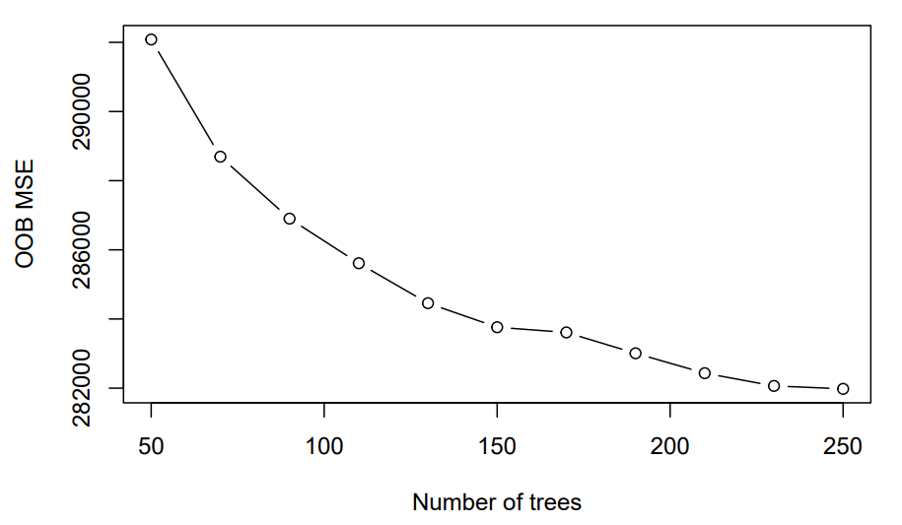
Ntree SELECTION

Slide 38
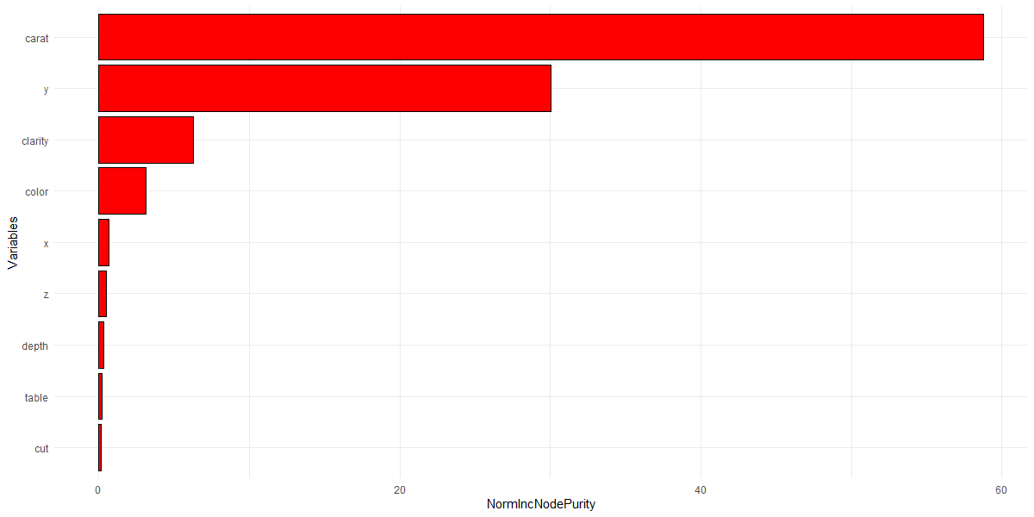
VARIABLES IMPORTANCE
carat
58.77
y
30.04
clarity
6.28
color
3.11
x
0.64
z
0.48
depth
0.30
table
0.21
cut
0.17

Slide 39
Training PSEUDO R²
TRAINING RMSE
TEST RMSE
0.9964
238.42
541.59

Slide 40
RANDOM FOREST
Ensemble methods
7

Slide 41
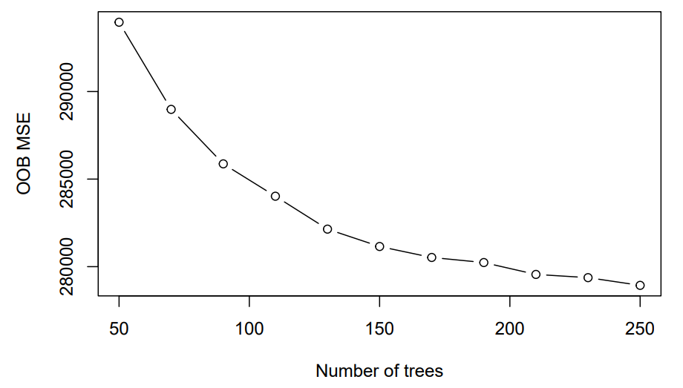
Ntree SELECTION

Slide 42
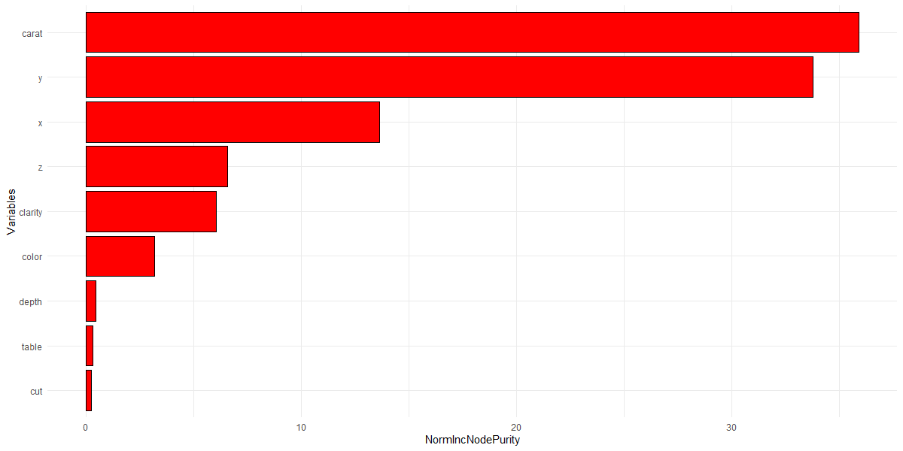
VARIABLES IMPORTANCE
carat
35.89
y
33.76
x
13.61
z
6.56
clarity
6.04
color
3.15
depth
0.44
table
0.29
cut
0.25

Slide 43
Training PSEUDO R²
TRAINING RMSE
TEST RMSE
0.996
250
536.21

Slide 44
conclusion
Which is the best method?
8

Slide 45
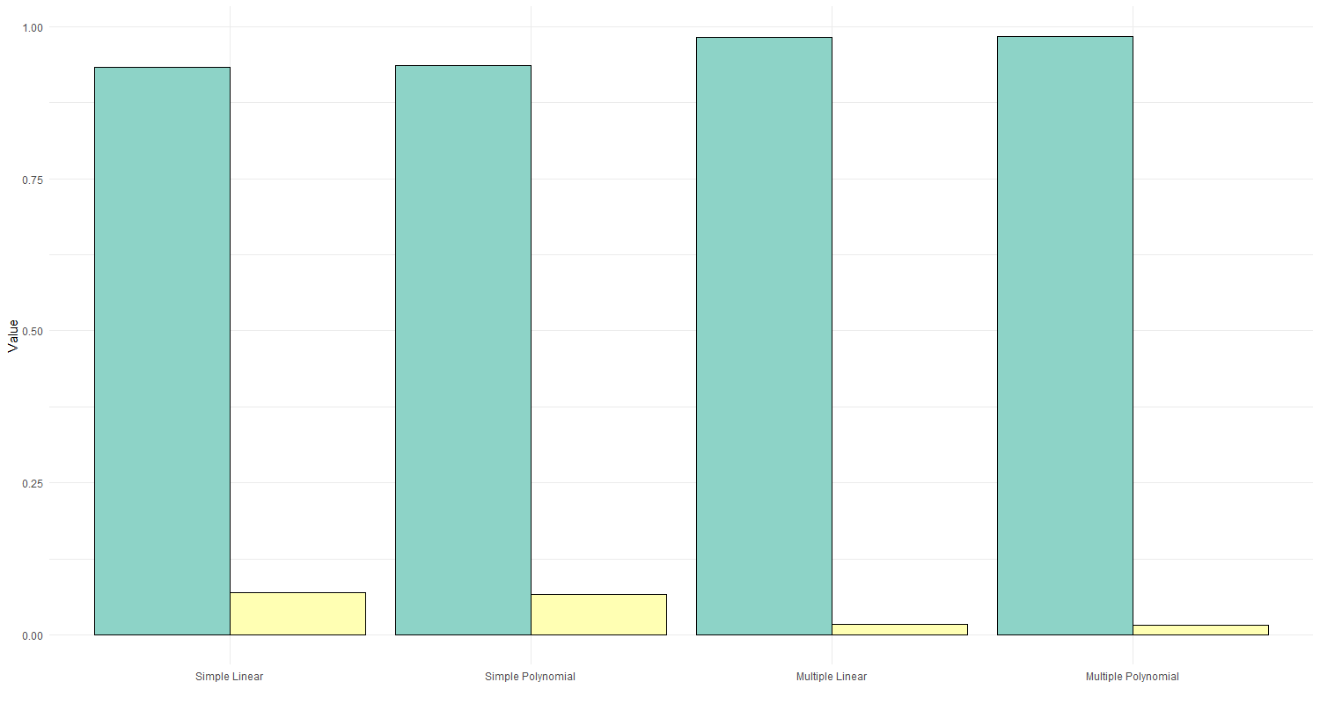
Parametric methods overview
0.982
0.984
0.933
0.936
Training R²
Test MSE
0.068
0.065
0.018
0.016
Simple Linear
Simple Polynomial
Multiple Linear
Multiple Polynomial

Slide 46
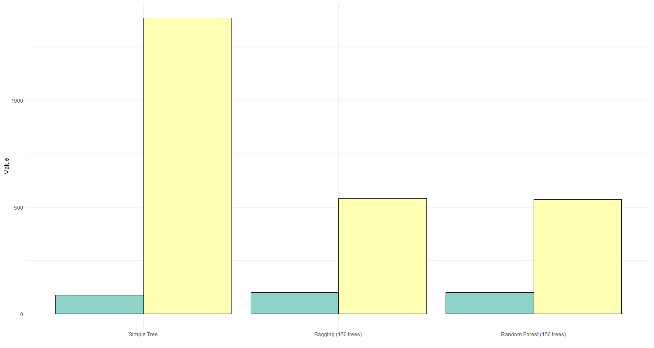
Non-Parametric methods overview
1386.03
Pseudo tr. R²
541.59
536.21
Test MSE
88.11
99.64
99.61
Simple Tree
Bagging (150 trees)
Random Forest
(150 trees)

Slide 47
KEY FINDINGS
Carat is the most important factor in determining a diamond’s price, strictly followed by the diamond’s dimensions.
Clarity plays the most important role among the categorical variables, followed by color and cut, whose impact is much smaller than clarity.
Table and depth, on the contrary, are not relevant.

Slide 48
ACCURACY–INTERPRETABILITY TRADE-OFF
The best model in terms of accuracy is probably random forest
However, the one yielding the most interpretable results (keeping high accuracy) is multiple linear regression

Slide 49

Thanks FOR WATCHING!

